Slide 1




SWOT Analysis
At Home Care Services in Canada
The growing need for Canadian Healthcare Workers
Comprehensive Market Analysis
July 15, 2025

Slide 2

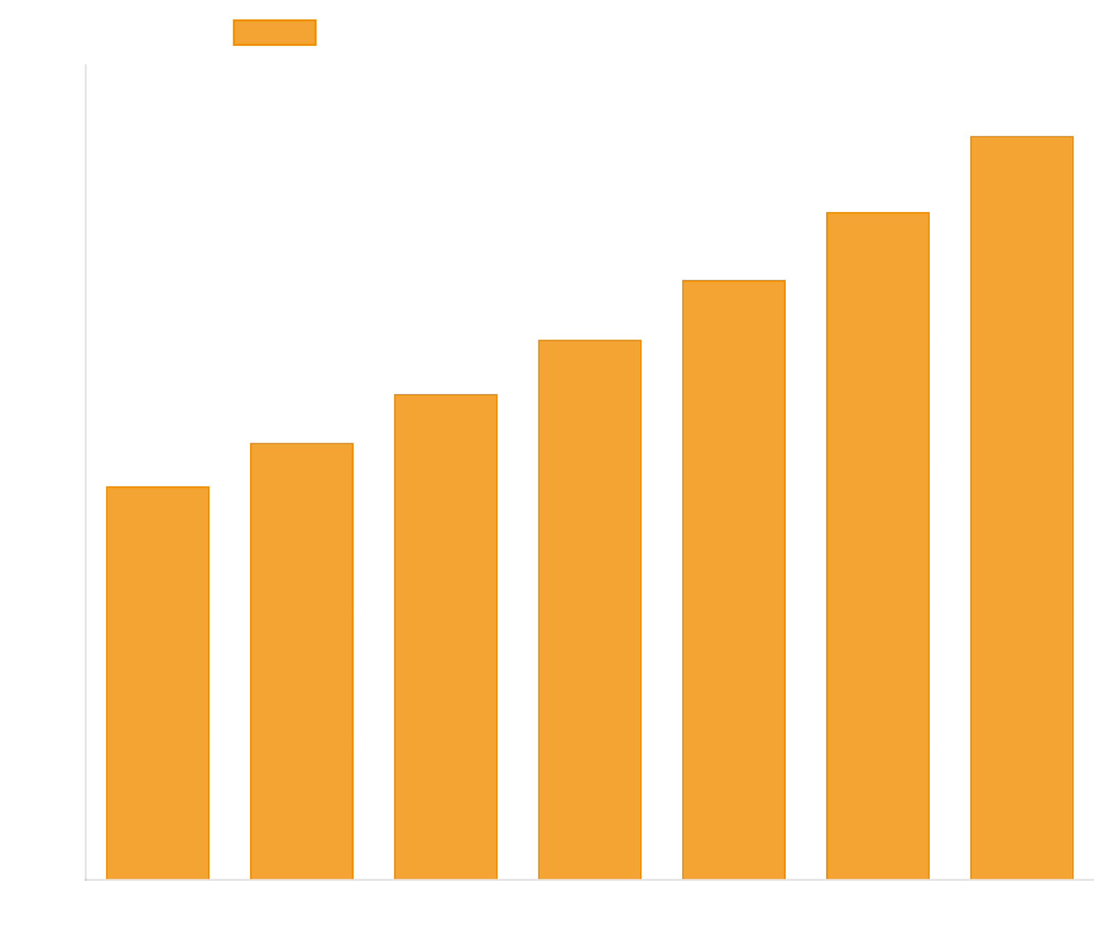
Canadian Home Care Market Overview
Market Size & Growth
The Canadian home care industry represents a rapidly growing healthcare sector driven by demographic shifts and changing consumer preferences. With strong projected growth, the market presents significant opportunities for service providers.
$14.5B
$27.4B
Market Size (2024)
Projected Size (2030)
11.2%
5,456
CAGR (2025-2030)
Businesses
Key Demographic Drivers
8% increase in population aged 85+ (2016-2021)
Population aged 100+ increased by 16% (2016-2021)
Seniors projected to represent 23-25% of population by 2036
Strong preference for aging in place vs institutional care

Slide 3





SWOT Matrix Overview
The SWOT analysis examines internal strengths and weaknesses alongside external opportunities and threats facing the Canadian home care industry. This comprehensive assessment provides a strategic foundation for decision-making and future planning.
Strengths
Weaknesses
Strong market growth (11.2% CAGR)
Critical staffing shortages
High service effectiveness (80-96% success rate)
Funding and financial constraints
Technology integration and innovation
Service access and wait time issues
Diverse service delivery models
Operational and administrative challenges
Established regulatory frameworks
Market fragmentation (5,456 businesses)
Opportunities
Threats
Demographic transformation (aging population)
Healthcare system pressures
Technology revolution (AI, wearables, telehealth)
Economic and financial risks
Market expansion and service diversification
Competitive landscape evolution
Policy and regulatory support
Regulatory and compliance risks
Industry consolidation potential
Operational and external risks

Slide 4

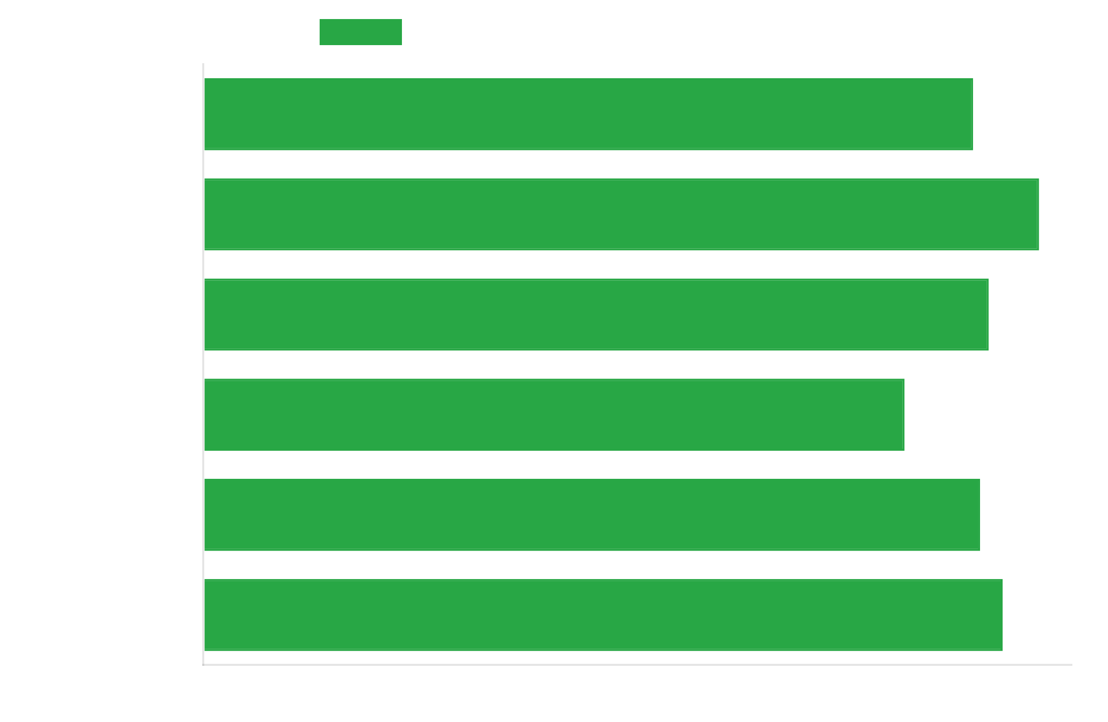



Strengths
Strong Market Growth
11.2% CAGR projected from 2025-2030, with market size growing from $14.5B to $27.4B.
Proven Service Effectiveness
80.8% to 96.3% effectiveness in helping recipients stay at home across provinces.
Technology Integration
Growing adoption of remote monitoring, telehealth, and IoT solutions enhancing care quality.
Diverse Service Models
Flexible public-private mix with specialized programs for various care needs.

Slide 5






Weaknesses
Despite strong market growth, the Canadian home care industry faces significant internal challenges that limit its ability to meet growing demand and deliver consistent quality of care across all regions.
Critical Staffing Shortages
Severe shortage of healthcare workers across provinces, high turnover rates, and burnout issues exacerbated by COVID-19. Part-time employment with inconsistent hours and low pay affecting worker stability.
Funding Constraints
Limited public funding as home care is not fully covered under Canada Health Act. Inconsistent funding levels across provinces creating inequitable access to services.
Service Access Issues
Geographic disparities between urban and rural areas. Long wait times, particularly in public system, with 475,000 Canadians reporting unmet home care needs in 2021.
Market Fragmentation
Industry structure of 5,456 businesses creates inconsistent service delivery models and quality standards. Limited economies of scale and competitive fragmentation.

Slide 6




Opportunities
The Canadian home care industry faces significant growth opportunities driven by demographic shifts, technological innovation, and evolving healthcare policies.
Demographic Transformation
Seniors projected to represent 23-25% of population by 2036, creating sustained demand growth.
Technology Revolution
AI and machine learning for predictive care planning, wearable technology for remote monitoring, and telehealth expansion.
Market Expansion
Private pay growth, service diversification, and geographic expansion to underserved areas.

Slide 7






Threats
Despite strong growth potential, the Canadian home care industry faces several significant external threats that could impact future performance.
Healthcare System Pressures
Hospital capacity issues and competition for limited healthcare funding.
Economic & Financial Risks
Inflation pressures on wages and supplies, and insurance coverage limitations.
Competitive Landscape Evolution
Entry of large healthcare corporations and technology disruptors.
Regulatory & Compliance Risks
Stricter regulations increasing compliance costs and evolving privacy requirements.

Slide 8

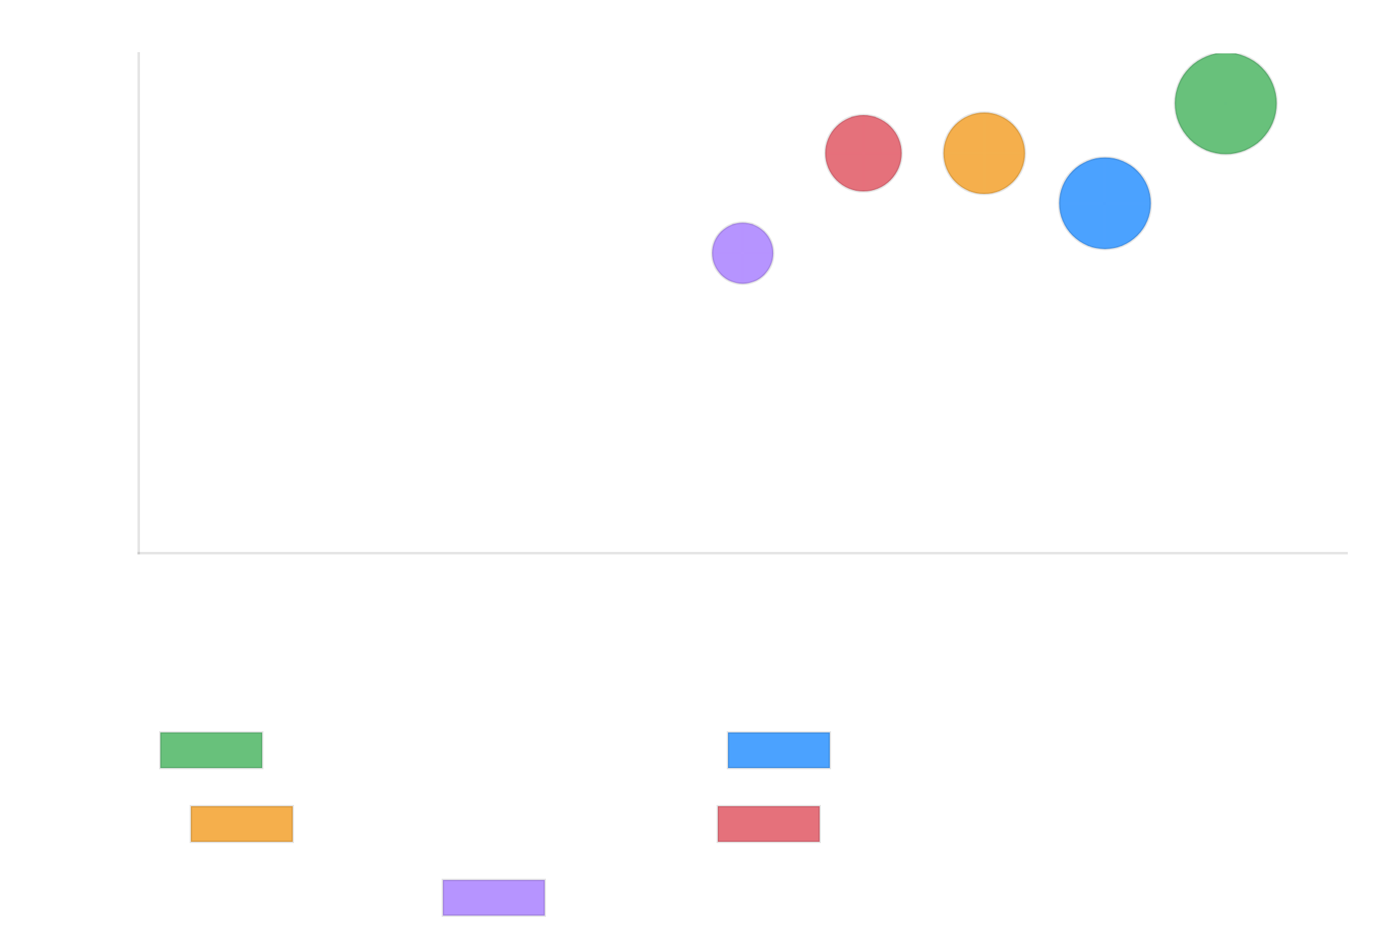



Strategic Implications & Recommendations
Key Success Factors
Strategic Priority Matrix
Workforce Development
Address staffing shortages through innovative recruitment and retention programs.
Technology Adoption
Leverage digital tools and telehealth to improve efficiency and care quality.
Service Differentiation
Develop specialized capabilities to stand out in a fragmented market.
Strategic Partnerships
Build relationships with healthcare systems and technology providers.
To capitalize on the $27.4B market opportunity by 2030, providers should prioritize workforce solutions and technology integration while developing specialized service offerings.

